Slide 1
AWS PINPOINT WITH AWS AMPLIFY
Shalni G

Slide 2
AGENDA
What is AWS Amplify ?
What is AWS Pinpoint ?
Use Case – My Pizza Store

Slide 3
What is aws amplify
AWS Amplify is a complete solution that lets frontend web and mobile developers easily build, ship, and host full-stack applications on AWS, with the flexibility to leverage the breadth of AWS services as use cases evolve. No cloud expertise needed.
With AWS Ampify we can create complex application using API yGatewat, Lambda etc with simple commands using amplify cli installed.
At the backend this amplify creates a Cloud Formation Stack where we can see all the updates of the Amplify, what are the services it creates, the status of creation etc.
With Amplify we can build three tier application with few commands, we don’t need to know about the services, what is happening in the background, we can also host application using amplify.
To know more about AWS Amplify visit - AWS Amplify blog

Slide 4
AWS PINPOINT
Amazon Pinpoint s an AWS service that you can use to engage with your customers across multiple messaging channels. You can use Amazon Pinpoint to send email, SMS text messages, voice messages, and push notifications.
AWS defines AWS Pinpoint as “Amazon Pinpoint is a flexible and scalable outbound and Inbound Marketing communications service.”
Let me simplify that for you. Imagine you are a budding entrepreneur and your brand has only a few customers, for example, you have only four customers. So, as part of giving your customers the best post-purchase experience, you decide to send them thank you mails and shop again messages.
You want to retain these existing customers, so you will manually send messages and emails to these four people about your upcoming discounts and other offers, right?
Since four is a small number four, you can manage sending notifications manually. But, what if the number is 40,000. It will be impossible for you to send individual emails and messages to 40,000 people.
To know more about it visit - Aws Pinpoint

Slide 5
USE CASE –My PIZZA STORE
Implemented Using AWS Pinpoint and AWS Amplify Services

Slide 6
Scenario
Lets take a scenario where we have a web application which lets user to buy Pizzas, we have two options in the web page the user can either Add the Pizza’s to the Cart or he can Buy(Checkout) the Pizza’s. If the User Add’s the Pizza and forgets to checkout and after an hour we will notify the user in a Email saying you haven’t bought your Pizza’s yet, just a reminder for the user to buy the pizza. Lets build this using AWS Pinpoint. We will make use of a react App.
Github - github

Slide 7
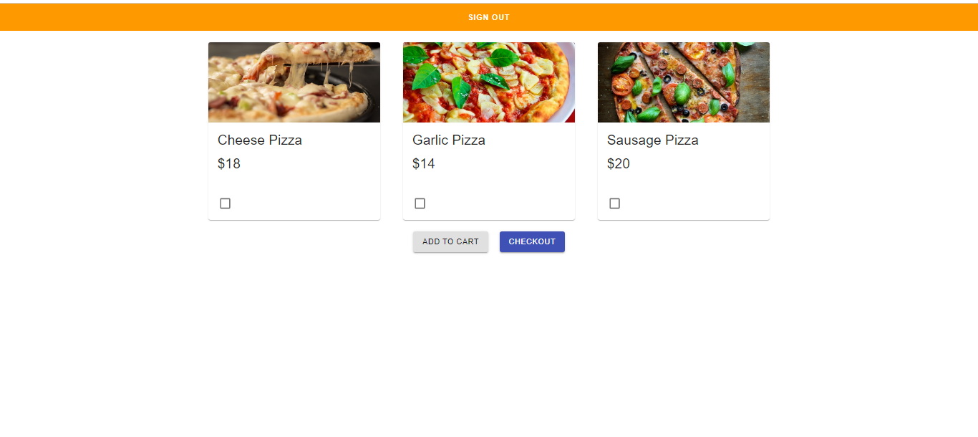
Application Overview :

Slide 8
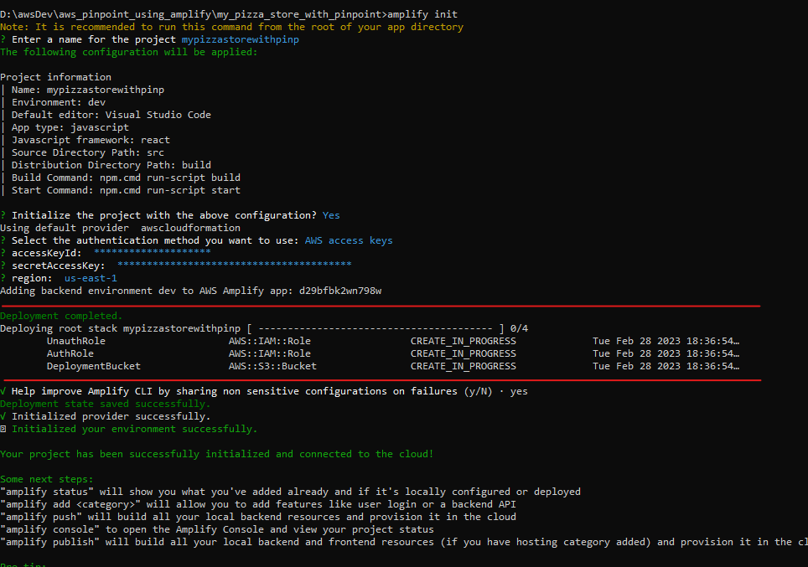
Steps to proceed:
→ Clone the git repository – git clone https://github.com/shalnimarialoudia/my_pizza_store_with_pinpoint.git
→ Install AWS Amplify - npm i -g @aws-amplify/cli
→ Install amplify libraries required for React: - npm i aws-amplify @aws-amplify/ui-react
→ Initialize Amplify - amplify.cmd init.
This will ask you a series of questions. You can notice
That the highlighted part is creating a S3 bucket to store
the project files, IAM role is being created.
→ After initializing if we look at our react folder inside
Src folder we can see a file being created src/aws-exports.js
This file is auto generated by the amplify where we will
Have all configuration related to the resources that is being
Created by the amplify.
Now in the index.js file add the following code to configure
the newly generated file. import {Amplify} from 'aws-amplify';
import awsmobile from './aws-exports';
Amplify.configure(awsmobile);
→ Now add Auth to the amplify – amplify add auth
Choose the default authentication(Cognito User Pool)
→ Now add the Analytics(Pinpoint) – amplify add analytics
→ Lets publish to amplify – amplify push

Slide 9
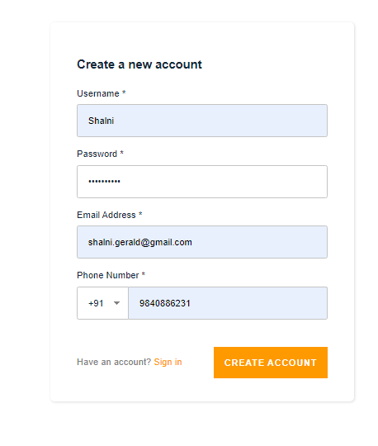
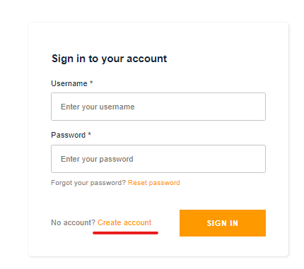
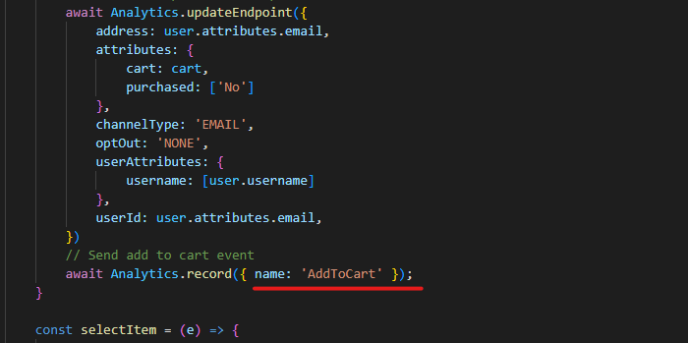
Now when you run the react application in local you can see a sign in page. You see this screen because of withAuthenticator(App) in which bounds the application with Cognito Authentication
Create a User by clicking create account this will add the details to the AWS Cognito User Pool.
Now navigate to Pinpoint Console and Under the
Settings → Email →Enable Email Channel for the Project with a verified email address.
Create a Segment in the Pinpoint Service. Segment is used to group the users, let’s say if we want to group the user based on whether they have purchased the order or they have just added the items to cart. We don’t want to send a reminder email to the users who have already purchase right, the segment helps in segregating the group.
Now lets create a journey. Start the journey with the type of event “AddToCart” this specify if the event has the AddToCart eventType then execute the journey
Now Add Activity with yes/no
Split

Slide 10
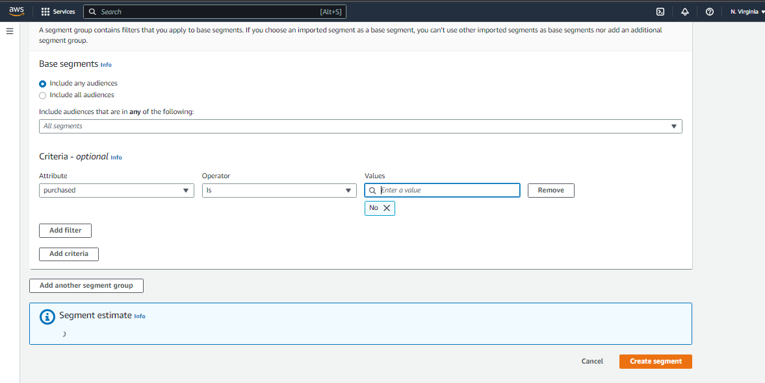
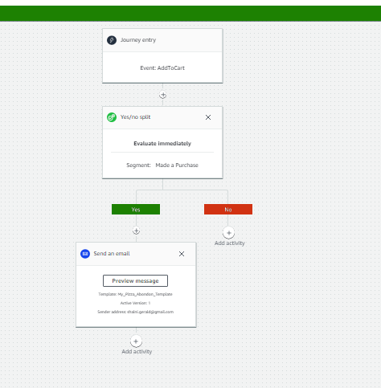

Slide 11
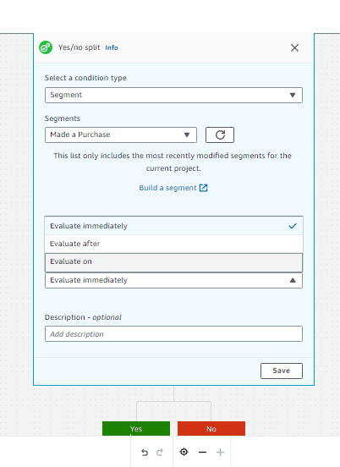
Now after setting the Event, Add an Activity -> select yes/no split with condition type as Segement and select a segement that was previously created, and select if you want to execute the yes/no activity immediately after the segment condition is met or after a delay say after one hour I want to send an email to the user.
After that add the yes or no activities. In our case triggering the email
Create an Email Template if you don’t have one already.
Review the Journey and test it out.
Now Lets host our frontend application in the cloud (AMPLIFY)
Command – amplify add hosting
I have added the SS in the next slide
→ After the red line we need to go to the AWS Console and amplify service and choose the Hosting Environment as Github and add the repo access permissions etc.

Slide 12
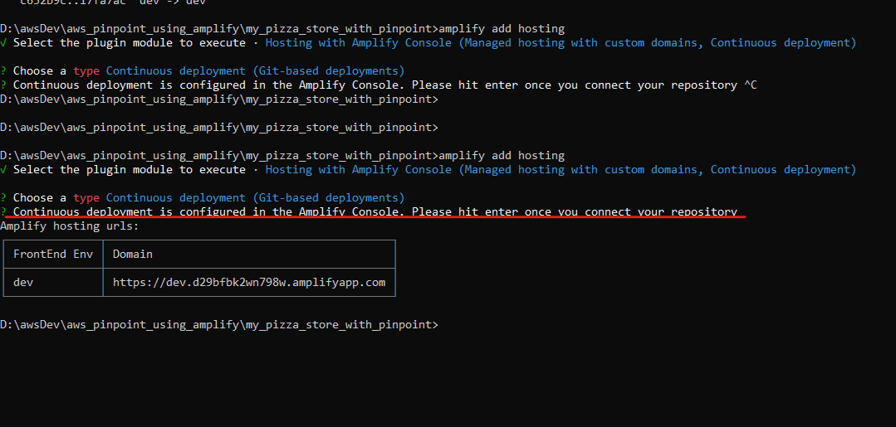

Slide 13
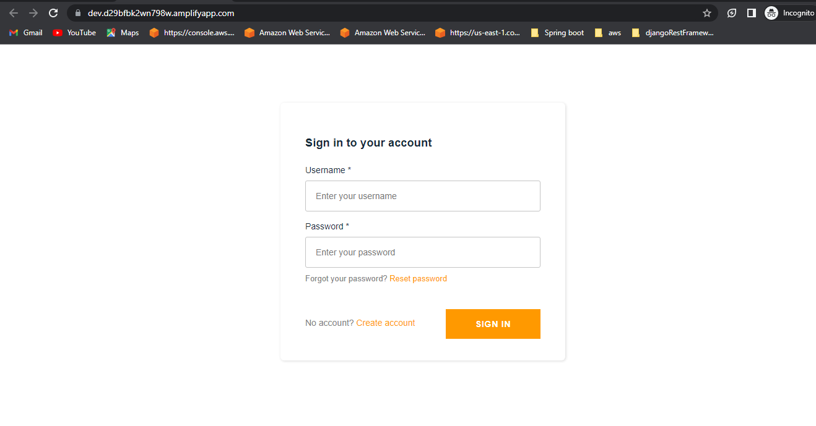
Output of hosting a website in AWS Amplify

Slide 14
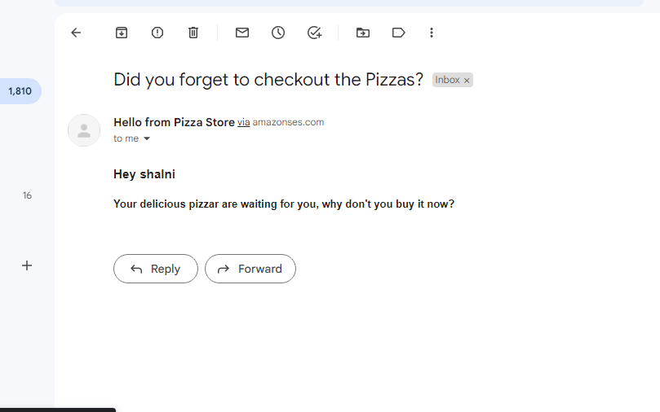
Output:

Slide 15
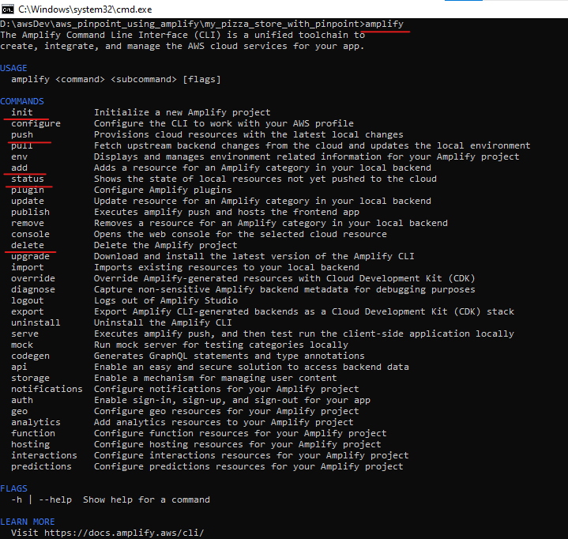
Amplify Help Commands :
→ To Know the commands available for Amplify execute the below command in Prompt
amplify init – initializes the project. Like for which IAM user to create the Amplify resource, what type of project, language etc.
amplify add <aws_resource> api –This command creates an API Gateway service. Likewise you can add auth, analytics etc.
amplify push – This command pushes the latest updates to the amplify and runs the cloud formation stack to create new resources.
amplify delete – This command deletes the amplify project and all the other resources created from it.

Slide 16
THANK YOU
G.Shalni Github - https://github.com/shalnimarialoudia
Youtube Video - https://www.youtube.com/watch?v=l0yHQ5OJp-I

